Slide 1

Python Regular Expressions
Chapter-5

Slide 2

Regular Expressions
A regular expression is a special sequence of characters that helps you match or find other strings or sets of strings, using a specialized syntax held in a pattern. Regular expressions are widely used in UNIX world.
The module re provides full support for Perl-like regular expressions in Python. The re module raises the exception re.error if an error occurs while compiling or using a regular expression.
There are various characters, which would have special meaning when they are used in regular expression. To avoid any confusion while dealing with regular expressions, we would use Raw Strings as r'expression'.
www.skillslash.com

Slide 3
Match Function
This function attempts to match RE pattern to string with optional flags.
Syntax:
re.match(pattern, string, flags=0)
Pattern: regular expression to be matched
String: This is the string, which would be searched to match the pattern at the beginning of string.
The re.match function returns a match object on success, None on failure. We usegroup(num) or groups() function of match object to get matched expression.
www.skillslash.com

Slide 4
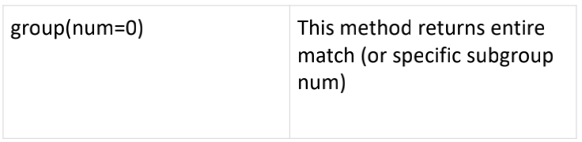
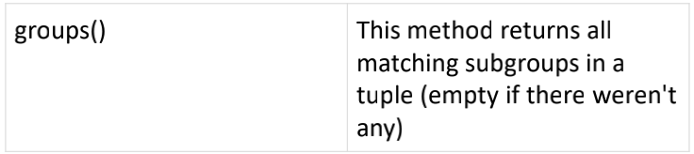
www.skillslash.com

Slide 5
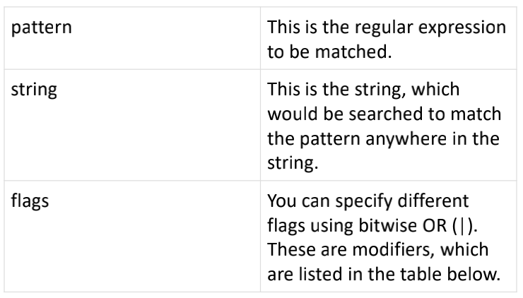
Search Function
• This function searches for first occurrence of RE pattern within string with optional flags.
• Here is the syntax for this function:
• re.search(pattern, string, flags=0).
www.skillslash.com

Slide 6
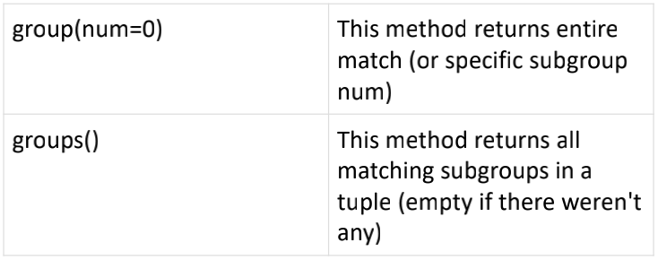
The re.search function returns a match objecton success, none on failure. We use group(num) or groups() function of match object to get matched expression.
www.skillslash.com

Slide 7
Matching vs Searching
Python offers two different primitive operations based on regular expressions:match checks for a match only at the beginning of the string, while searchchecks for a match anywhere in the string (this is what Perl does by default).
www.skillslash.com

Slide 8
Search and Replace
One of the most important re methods that use regular expressions is sub.
re.sub(pattern, repl, string, max=0)This method replaces all occurrences of the RE pattern in string with repl, substituting all occurrences unless max provided.
This method returns modified string.
www.skillslash.com

Slide 9
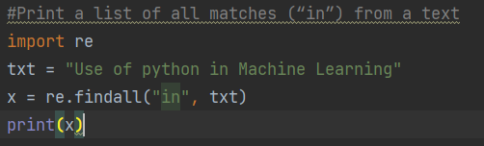
Regular expression Example:
Notes:
#Print a list of all matches (“in”) from a text import re txt = "Use of python in Machine Learning" x = re.findall("in", txt) print(x)

Slide 10
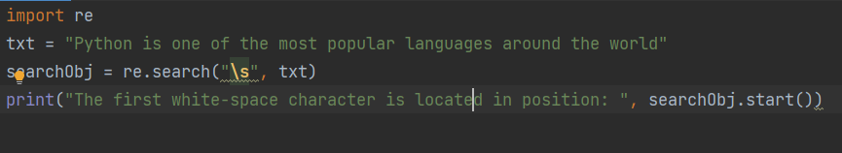
Regular expression Search():
The search() function searches the string and returns a match object if match is found.
However, if there are more than one match, only the first occurrence of the match will be returned.
Notes:
import re txt = "Python is one of the most popular languages around the world" searchObj = re.search("\s", txt) print("The first white-space character is located in position: ", searchObj.start())

Slide 11
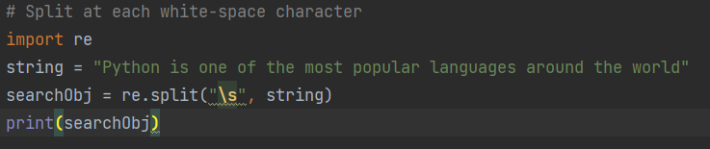
Regular expression Split():
The split() function in RegEx returns a list where the string has been split at each match -.
Notes:
# Split at each white-space character import re string = "Python is one of the most popular languages around the world" searchObj = re.split("\s", string) print(searchObj)

Slide 12
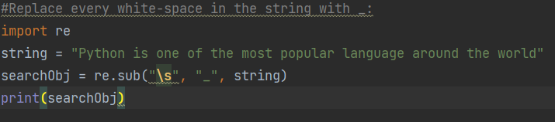
Regular expression Sub():
The sub() function in RegEx is to replace the match with the text of your choice.-.
Notes:
#Replace every white-space in the string with _: import re string = "Python is one of the most popular language around the world" searchObj = re.sub("\s", "_", string) print(searchObj)

Slide 13
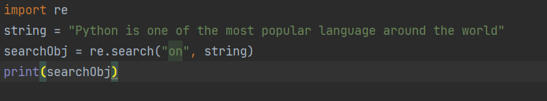
Regular expression Match object:
A match object in RegEx is an object containing information about the search and the result. In no match found, None is returned. :
Search a string and returned match object.
Notes:
import re string = "Python is one of the most popular language around the world" searchObj = re.search("on", string) print(searchObj)

Slide 14
Regular expression Match object:
A match object in RegEx is an object containing information about the search and the result. In no match found, None is returned. :
Search a string and returned match object.
Notes:
import re string = "Python is one of the most popular language around the world" searchObj = re.search("on", string) print(searchObj)

Slide 15
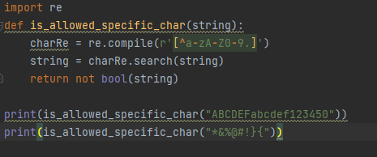
Example
Write a Python program to check that a string contains only a certain set of characters (in this case a-z, A-Z and 0-9).
Notes:
import re def is_allowed_specific_char(string): charRe = re.compile(r'[^a-zA-Z0-9.]') string = charRe.search(string) return not bool(string) print(is_allowed_specific_char("ABCDEFabcdef123450")) print(is_allowed_specific_char("*&%@#!}{"))

Slide 16
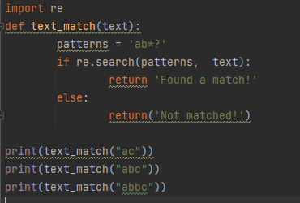
Example
Write a Python program that matches a string that has an a followed by zero or more b's
Notes:
import re def text_match(text): patterns = 'ab*?' if re.search(patterns, text): return 'Found a match!' else: return('Not matched!') print(text_match("ac")) print(text_match("abc")) print(text_match("abbc"))

Slide 17
Exercise : 1
Given a string like :
2004-959-559 # This is Phone Number
Please write the regular expression to fetch only the numbers from the above string
Notes:
#!/usr/bin/python import re phone = "2004-959-559 # This is Phone Number" # Delete Python-style comments num = re.sub(r'#.*$', "", phone) print( "Phone Num : ", num) # Remove anything other than digits num = re.sub(r'\D', "", phone) print ("Phone Num : ", num)

Slide 18
Exercise : 2
Write a Python program to match a string that contains only upper and lowercase letters, numbers, and underscores.
Notes:
import re def text_match(text): patterns = '^[a-zA-Z0-9_]*$' if re.search(patterns, text): return 'Found a match!' else: return('Not matched!') print(text_match("The quick brown fox jumps over the lazy dog.")) print(text_match("Python_Exercises_1"))

